Slide 1

The Inspections Process

Slide 2

References
Army Regulation 20-1, Inspector General Activities and Procedures
Army Regulation 1-201, Army Inspection Policy
The Inspections Guide
The Inspections Process Diagram

Slide 3
The Inspections Process
Three Phases
ELO
9
Preparation Phase
Execution Phase
Completion Phase
The Inspections Guide, Section 4-1, page 4-1-1

Slide 4
The Inspections Process
RESEARCH
DEVELOP CONCEPT
PLAN IN DETAIL
TRAIN UP
PREPARATION
1
2
CDR
4
5
APPROVES CONCEPT
3
PRE-INSPECTION VISITS
6
IPR
8
ANALYZE
RESULTS
CROSSWALK
OUT-BRIEF PROPONENT
VISIT UNITS
EXECUTION
7
UPDATE CDR
10
11
9
OUT-BRIEF CDR
FINALIZE REPORT
DISTRIBUTE REPORT
SCHEDULE FOLLOW-UP
COMPLETION
12
TASKERS
14
16
17
HANDOFF
13
15
The Inspections Guide, Chapter 4

Slide 5
The Inspections Process
Phase One: The Preparation Phase
RESEARCH
DEVELOP CONCEPT
PLAN IN DETAIL
TRAIN UP
1
2
CDR
4
5
APPROVES CONCEPT
3
PRE-INSPECTION VISITS
6
The Inspections Guide, Section 4-2, pages 4-2-2 to 4-2-7

Slide 6

Research
Conducting research on the inspection topic is the most
important step of the whole inspection.
In order to conduct research successfully, you must . . .
  Consider the commander’s (narrows scope) guidance about the topic.
  Consider your command IG’s guidance.
  Gather all available information on the topic (regulations, field manuals, and so on).
  Study the results of previous IG inspections on the same – or a similar – topic. DAIG’s inspections are at (requires AKO access): https://armypubs.us.army.mil/publications/administrative/pog/TIG.aspx
  Request a briefing or interview with the topic’s proponent or a subject-matter expert.
  Determine what standards apply to the topic.
  Search the Internet for any applicable information on the topic.

Slide 7
Research
Define the System
What is the system, program, or function you are inspecting?
Define the system using the functional modeling (or some other) approach
Controls
Where does the system seem to be ‘clogging up’?
Those possible ‘clogs’ in the system help focus the objectives.
(policy, requirements, constraints, supervision, budget, time, etc.)
Inputs
Outputs (results)
(material, people, information)
Activity / Function
Activity /
Function
Mechanisms
Activity /
(activities, support, facilities, equipment, costs, etc.)
Function
The Inspections Guide, Section 4-2, Step 1
Feedback

Slide 8
Research
Example Functional Model
Inspection of Composite Risk Management for 66th Infantry Division
Dir Army Staff:
AR 385-10, Army Safety Program
Inputs / Controls
G-1 (ACOM):
FORSCOM REG 385-1
(material, people, information / policy, requirements,
constraints, supervision,
budget, time, etc.)
Senior Mission Commander: Policy / Guidance
Soldiers / Civilians: Responsible for accident prevention by applying RM; employ RM in managing risk.
Supervisors and Operators: Responsible for RM during planning, preparation, and execution of all operations
Process / Mechanisms
Army Leaders: Integrate RM, as described in DA PAM 385-30, into mission activities to prevent the accidental loss of personnel, facilities, weapons systems, and equipment during peacetime and wartime.
(activities, support, facilities, equipment, costs, etc.)
Commanders Within FORSCOM: Establish and publish risk- approval authority levels for decision-making.
Army resources (to include Soldiers, DA Civilians, and Army property) safeguarded and preserved worldwide by using risk management as the Army’s principle risk- reduction methodology.
Outputs
(results)
The Inspections Guide, Section 4-2, Step 1
Practical Exercise 1

Slide 9
Research
(continued)
Use the information you glean from your research to refine the purpose of the inspection and narrow the scope.
The physical outputs of this step are the Inspection Purpose and the Inspection Objectives.
The Inspection Purpose is a clear statement of the inspection’s overarching goal.
The Inspection Objectives are the most important features of the inspection plan because they will drive the information-gathering portion of the inspection.
  An inspection objective should be clear, concise, and capture the essence of what the inspection team wants to learn.
  Develop at least three objectives but no more than five.

Slide 10
Research
(continued)
Sample inspection objectives:
Objective 1: Determine if units within the division are conducting Sexual Harassment/Assault Response & Prevention (SHARP) training annually in accordance with Army Regulation 350-1, Army Training and Leader Development.
or
Objective 1: Assess the division's Sexual Harassment / Assault Response & Prevention (SHARP) training program to determine its effectiveness.
Practical Exercise 2

Slide 11
The Inspections Process
Phase One: The Preparation Phase
RESEARCH
DEVELOP CONCEPT
PLAN IN DETAIL
TRAIN UP
1
2
CDR
4
5
Purpose
Objectives
APPROVES CONCEPT
3
PRE-INSPECTION VISITS
6
The Inspections Guide, Section 4-2, pages 4-2-8 to 4-2-10

Slide 12

Develop the Concept
The inspection concept is the blueprint for your inspection plan and forms the basis of your concept-approval briefing.
The concept is nothing more than a plan that outlines – in general – how the inspection team plans to accomplish the inspection.
The concept plan can take the form of a memorandum or a slide briefing – or both (the physical output of this step).

Slide 13
Develop the Concept
(continued)
The inspection concept must have – at a minimum – the following items:
Inspection Purpose (from the Research step)
Inspection Objectives (from the Research step)
Scope of the Inspection (describes the unit types and sampling size; and the team’s organization, i.e. number of IGs, augmentees, and SMEs)
Focus (a “general” or “special” inspection)
Timing of Feedback (explains when the commander can expect to receive feedback on the inspection)
Timeline (outlines the key milestone dates)
Notification (explains how the inspection teams plan to notify the inspected units – announced or unannounced (not recommended))
Practical Exercise 3

Slide 14
The Inspections Process
Phase One: The Preparation Phase
RESEARCH
DEVELOP CONCEPT
PLAN IN DETAIL
TRAIN UP
1
2
CDR
4
5
Purpose
Objectives
Concept
Memo
APPROVES CONCEPT
3
PRE-INSPECTION VISITS
6
The Inspections Guide, Section 4-2, pages 4-2-11 to 4-2-17

Slide 15
The Commander Approves
the Concept
Schedule a time to brief your commander to gain his or her approval of your inspection concept.
Prepare a decision briefing from your Concept Memorandum and follow the same format.
Prepare an Inspection Directive for your commander’s signature immediately following the briefing.
The physical output of this step is the one-page Inspection Directive, which should include the following:
  A statement directing the Inspector General to conduct the inspection
  A list of all objectives that pertain to the inspection
  A statement that outlines tasking authority for all active, Reserve, National Guard, and tenant organizations
  A statement that authorizes the IG to have access to all Army activities, organizations, and information sources required to conduct the inspection

Slide 16
The Inspections Process
Phase One: The Preparation Phase
RESEARCH
DEVELOP CONCEPT
PLAN IN DETAIL
TRAIN UP
1
2
CDR
4
5
Purpose
Objectives
Concept
Memo
APPROVES CONCEPT
3
PRE-INSPECTION VISITS
Concept Briefing
Inspection Directive
6
The Inspections Guide, Section 4-2, pages 4-2-18 to 4-2-34

Slide 17
Plan in Detail
Planning the details of your inspection is a critical step of the Preparation Phase.
The physical outputs of this step are as follows:
  Sub-Tasks for the Objectives
  Methodology
  Notification Letter (includes the Warning Order)
  Detailed Inspection Plan **(most important physical output)

Slide 18
Plan in Detail
Developing Sub-Tasks
Sub-Tasks are tasks that focus the inspection team on specific ways to seek information and then answer the basic requirement of an inspection objective.
Developing Sub-Tasks requires a great deal of thought and relies greatly upon information gleaned from the Research step of the Preparation Phase.
Subject-matter experts and the applicable standards, policies, and regulations are your best sources of information when developing Sub-Tasks.
Sub-Tasks form the basis for the findings that an inspection team will generate for the final inspection report.

Slide 19
Plan in Detail
Information-Gathering Domains
The IG’s Sources of Information
ELO
10
Interviews with key leaders or personnel.
Sensing Sessions with enlisted Soldiers, NCOs, and officers.
Reviews of pertinent documents such as SOPs, policy letters, post regulations, training-guidance memorandums, and so on.
Observation (Live Fire Exercises (LFX), Field Training Exercises (FTX), Military Decision Making Process (MDMP) exercises, after-action reviews, inspections, and so on).
Surveys and Questionnaires (normally used for Special-Interest Items that only require a sampling of a unit’s population).
The Inspections Guide, Section 4-2, page 4-2-18

Slide 20
Plan in Detail
Developing Sub-Tasks
Example
2. Objective: Determine if leaders at all levels throughout the division understand – and can implement – the division’s Force Protection plan.
Sub-tasks:
2.1 Interview BDE / BN Commanders to determine if they understand the requirements and intent of the division’s Force Protection plan.
2.2 Conduct sensing sessions with company grade officers, NCOs, and enlisted Soldiers to determine if they understand -- and are able to implement -- the division’s Force Protection plan.
2.3 Review unit Force Protection SOPs and policies to determine if these documents adhere to the requirements of the division Force Protection plan.
2.4 Observe unit Force Protection training, drills, and operations (as available) to determine if the units are complying effectively with the division’s Force Protection plan.
Practical Exercise 4

Slide 21
Plan in Detail
Developing a Methodology
A methodology is nothing more than the inspection team’s plan for physically conducting an inspection at a unit or staff agency.
The Sub-Tasks you developed for your objectives will drive your methodology.
The physical outputs of developing a methodology are as follows:
  Task Organization of the Inspection Team (includes augmentees)
  Baseline Methodology
  Sample Inspection Itinerary

Slide 22
Plan in Detail
Task Organization of the Inspection Team
Team A Team B
MAJ List (Armor)* CPT Numero (Aviation)
MSG Smith (Supply) SFC Bergerac (Maintenance)
Maintenance (G-4) Supply (G-4)
Personnel (G-1) Personnel (G-1)
Security (G-2) Security (G-2)
*MAJ List is the overall leader of the inspection effort.

Slide 23
Plan in Detail
Baseline Methodology
The Baseline Methodology is the standard approach that the inspection team (or teams) will follow during an inspection visit.
The Baseline Methodology will include information-gathering assignments to team members.
Each team member must have a specific function within the team (interviewer, sensing-session facilitator, document reviewer, and observer).

Slide 24
Plan in Detail
Baseline Methodology (continued)
The Baseline Methodology will look as follows:
  Personnel to interview (interviews and sensing sessions)
    Brigade and Battalion Commanders / CSMs / OIP Coordinator (MAJ List / CPT Numero – Interviewers)
    Directorate heads / Primary Staff Members (MAJ List / CPT Numero – Interviewers)
    Company Commanders and First Sergeants (MSG Smith / SFC Bergerac – Sensing Session)
    Senior NCOs within the staff agencies (MSG Smith / SFC Bergerac – Sensing Session)
  Documents to Review (on site or in advance)
    Division, Brigade, and Battalion OIP documents (MAJ List / CPT Numero)
    OIP results for the past two years (especially company / detachment Initial Command Inspections) (MSG Smith / SFC Bergerac / G-1 / G-2 / G-4)
    Unit SOPs relating to OIPs (MSG Smith / SFC Bergerac / G-1 / G-2 / G-4)
    Training schedules to check OIP scheduling (MSG Smith / SFC Bergerac)
    Training Guidance or Command Philosophy memorandums that include OIP guidance (MAJ List / CPT Numero)
  Observation
    Observe scheduled inspections as available (All team members)

Slide 25
Plan in Detail
Baseline Methodology (continued)
The Baseline Methodology should also indicate how long an inspection team will spend at a unit or staff agency.
  Division or Tenant Unit: One Day
  Division or Installation Staff Agency: Half Day

Slide 26
Plan in Detail
Sample Inspection Itinerary
The Sample Inspection Itinerary allows the team to apply time constraints to the information-gathering requirements outlined in the Baseline Methodology.
  0800-0815 Conduct unit In-Briefing with commander and staff (All team members)
  0830-0930 Interview unit commander (MAJ List / G-2)
  0830-1000 Sensing Session with Company Commanders and First Sergeants (MSG Smith / G-1)
  0930-1030 Interview unit OIP Coordinator (MAJ List / G-2)
  1000-1130 Review documents (MSG Smith / G-1 / G-4)
  1300-1400 Interview Primary Staff Member (MAJ List / G-2)
  1300-1430 Sensing Session with senior staff NCOs (MSG Smith / G-1)
  1400-1530 Observe Staff Inspection of unit S-4 (MAJ List / G-4)
  1530-1630 IG Team IPR / Out-Briefing Preparation (All team members)
  1645-1715 Out-Briefing (All team members)

Slide 27
Plan in Detail
Notification Memorandum
The Notification Memorandum (or letter) officially notifies the unit or staff agency that an inspection is forthcoming.
To draft this memo, the Inspection Team must choose the units and staff agencies that the team (or teams) will visit.
A signed copy of the Notification Memorandum should go to all affected units and staff agencies at least six weeks before the first unit visit.
A telephonic Warning Order will normally precede the Notification Memorandum by at least one week.

Slide 28
Plan in Detail
Contents of the Notification Memorandum
The Notification Memorandum should include the following:
  Background information about the inspection
  Purpose of the inspection
  A listing of the units that the IG team (or teams) will visit
  The Inspection Objectives
  The Baseline Methodology for the inspection
  Feedback requirements
  A basic timeline
  A copy of the signed Inspection Directive as an enclosure
Practical Exercise 5

Slide 29
Plan in Detail
Detailed Inspection Plan
The Detailed Inspection Plan is the single most important planning document that the Inspection Team will produce.
This document requires the greatest amount of detail possible so that – once issued – the document anticipates and answers the questions of all affected units and staff agencies.
A good, solid Detailed Inspection Plan (Operations Order) will answer most – but not all – of the inspected unit or staff agency’s questions.

Slide 30
Plan in Detail
Contents of the Detailed Inspection Plan
At a minimum, the Detailed Inspection Plan should include the following:
  Directive
  Inspection Purpose
  Inspection Objectives
  Task Organization
  Inspection Locations and Schedule
  Inspection Approach
  Interview Requirements
  Special Items of Interest
  Inspection Itineraries
  Document Requests
  Resources
  Administrative Support
  Requirements
  Report Completion Timeline
  Suspense Summary
  Distribution
Practical Exercise 6

Slide 31
The Inspections Process
Phase One: The Preparation Phase
RESEARCH
DEVELOP CONCEPT
PLAN IN DETAIL
TRAIN UP
1
2
CDR
4
5
Purpose
Objectives
Concept
Memo
APPROVES CONCEPT
3
Sub-Tasks
Methodology
  Task Organization
  Baseline Methodology
  Sample Itinerary
Notification letter
Detailed Inspection Plan
PRE-INSPECTION VISITS
Concept Briefing
Inspection Directive
6
The Inspections Guide, Section 4-2, pages 4-2-35 to 4-2-42

Slide 32
Train Up
The Inspection Team’s Time
  Arrange for classes taught to the Inspection Team by Subject-Matter Experts (SME).
  Incorporate the augmentation personnel into the Inspection Team and assign them specific duties and responsibilities.
  Augmentation personnel must be administered the IG oath, trained on the tenet of confidentiality, and trained on the nature of IG records and IG System Concept to become Temporary Assistant IGs.
  Develop your information-gathering tools such as interview questions, sensing-session questions, and observation spot reports.
  (The Inspections Guide, page 4-2-34)
  Rehearse your interviews, sensing sessions, and other aspects of your planned methodology that you may need to “shake out.”

Slide 33
Train Up
Developing Information-Gathering Tools
  The Information-Gathering tools you develop for your inspection must focus on your objectives and how to gather information to answer those objectives.
  Information-Gathering tools include:
    Interview Questions
    Sensing-Session Questions
    Observation Spot-Report Formats
    Guidelines for Document Reviews
    Surveys or Questionnaires

Slide 34
Train Up
Developing Information-Gathering Tools
  Guidelines for developing interview and sensing-session questions are as follows (see Section 4-2, Step 5, in The Inspections Guide) :
    The questions should focus on answering the information requirements of the Sub-Tasks.
    Develop open-ended questions that encourage discussion.
    Develop questions designed to get at the root cause of any non-compliance.
    Tailor the questions to fit the person (or persons) whom you will interview or sense.
Practical Exercise 7

Slide 35
The Inspections Process
Phase One: The Preparation Phase
RESEARCH
DEVELOP CONCEPT
PLAN IN DETAIL
TRAIN UP
1
2
CDR
4
5
Purpose
Objectives
Concept
Memo
Info-gathering Tools
Rehearsals
APPROVES CONCEPT
3
Sub-Tasks
Methodology
  Task Organization
  Baseline Methodology
  Sample Itinerary
Notification letter
Detailed Inspection Plan
PRE-INSPECTION VISITS
Concept Briefing
Inspection Directive
6
The Inspections Guide, Section 4-2, pages 4-2-43 to 4-2-44

Slide 36
Pre-Inspection Visits
  Pre-Inspection Visits are necessary to validate – and refine – your inspection methodology and your information-gathering tools (interview questions, etc.).
  The Inspection Team should conduct a Pre-Inspection Visit for each type of unit or agency the team will visit (for example, a battalion and a staff agency).
  Conduct the Pre-Inspection Visit exactly as outlined in the Detailed Inspection Plan, but do not use the information gleaned from this visit in the final inspection report.

Slide 37
The Inspections Process
Phase One: The Preparation Phase
RESEARCH
DEVELOP CONCEPT
PLAN IN DETAIL
TRAIN UP
1
2
CDR
4
5
Purpose
Objectives
Concept
Memo
Info-gathering Tools
Rehearsals
APPROVES CONCEPT
3
Sub-Tasks
Methodology
  Task Organization
  Baseline Methodology
  Sample Itinerary
Notification letter
Detailed Inspection Plan
PRE-INSPECTION VISITS
Concept Briefing
Inspection Directive
6

Slide 38
VISIT UNITS
The Inspections Process
Phase Two: The Execution Phase
IPR
8
ANALYZE RESULTS
VISIT
OUT-BRIEF PROPONENT
UNITS
CROSSWALK
7
10
11
UPDATE CDR
9
The Inspections Guide, Section 4-3, pages 4-3-2 to 4-3-6

Slide 39
Visit Units
Be open and discreet!
  Execute your methodology and the itinerary you developed with the unit or staff agency.
  Conduct your in-briefing to inform the unit or staff agency’s leaders of the purpose and scope of your inspection
  Conduct interviews, sensing sessions, document review, and observation using the information-gathering tools you developed during the Train-Up step of the Preparation Phase.
  Provide inspected commanders, staff members, or proponents a written or verbal out-briefing (focus on IG findings and not sources)
    Avoid attribution when sharing your observations
      Attribution of good news is okay (AR 20-1, para. 5-1, j&k)
    The IG may leave a hard-copy version of the out-brief with the command

Slide 40

Visit Units
Write the Trip Report
  Immediately following an inspection visit to a unit or staff agency, the team members must compile their information into a Trip Report. Trip Reports …
    Are the team’s primary-source documents for writing the Final Report.
    Are memorandums that allow the team members to
    capture the information they just gathered.
    Are a permanent IG record of the inspection visit.
    Keep the Inspection Team from losing important data
    that team members can easily forget.

Slide 41
Visit Units
Writing a Trip-Report Observation
Each observation should include some or all of the following elements:
  Raw-data information – Unprocessed examples of what you saw, read, or heard.
  Synthesized information – Sentences that combine raw-data information in an effort to summarize that information.
  Analyzed information – Sentences that critically examine and process raw-data information in an effort to glean greater meaning from the data.
  Inspector’s Opinion – The observer’s sense or impression of the event or people interviewed.
Practical Exercise 8

Slide 42
The Inspections Process
Phase Two: The Execution Phase
IPR
8
ANALYZE RESULTS
VISIT
OUT-BRIEF PROPONENT
UNITS
CROSSWALK
7
10
11
Trip Report
UPDATE COMMANDER
9
The Inspections Guide, Section 4-3, pages 4-3-7 to 4-3-18

Slide 43
Conduct an
In-Process Review (IPR)
ELO
1
  The purpose of the IPR is to share and discuss the information that the team members have gleaned from their visits to units and staff agencies.
  Conduct an IPR following every inspection visit or after several visits.
  Conduct the IPR as an organized, well-prepared meeting that has an agenda and a means of collecting the data for open consideration by all team members.
    Sample IPR Worksheet
    Sample Trends Analysis Sheet
The Inspections Guide, Section 4-3, pages 4-3-7 to 4-3-10

Slide 44
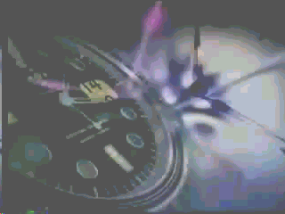

Conduct an
In-Process Review (IPR)
Sample Agenda
  Review of Administrative Issues
  Calendar Updates and Changes
  Complete the IPR Worksheet
    By Objective
    By Team (or team member)
    By Information-Gathering Domain (results of interviews, etc.)
  Output: Completed Trends Analysis Sheet or an Out-Briefing
  Final Comments and guidance by the person in charge of the inspection
Practical Exercise 9

Slide 45
UPDATE COMMANDER
The Inspections Process
Phase Two: The Execution Phase
IPR
8
Trends Analysis
Unit Out-Briefing
ANALYZE RESULTS
VISIT
OUT-BRIEF PROPONENT
UNITS
CROSSWALK
7
10
11
Trip Report
UPDATE COMMANDER
9
The Inspections Guide, Section 4-3, page 4-3-19

Slide 46
Update the Commander
  Your commander may request an in-progress update of the inspection.
  In most cases, you will develop an information briefing to update the commander on the current trends you are finding.
  Refer to the most up-to-date version of your Trends Analysis Sheet for information to include in the briefing.
  Review the concept and inspection schedule with your commander as part of the briefing.

Slide 47
UPDATE COMMANDER
The Inspections Process
Phase Two: The Execution Phase
IPR
8
Trends Analysis
Unit Out-Briefing
ANALYZE RESULTS
VISIT
OUT-BRIEF PROPONENT
UNITS
7
CROSSWALK
10
11
Trip Report
UPDATE COMMANDER
9
The Inspections Guide, Section 4-3, pages 4-3-20 to 4-3-32
Update Briefing

Slide 48
Analyze the Results
and Cross-walk
Write the Final Report
  Analyzing the results means that you must now organize the inspection team to begin writing the Final Report.
  Develop a game plan that assigns writing responsibilities to the team members.
  Develop a Final Report format, to include a standard format for each of the major chapters.
  Set a Final Report timeline that gives your team members enough time to analyze and write their findings and conduct cross-walking as necessary.

Slide 49
Analyze the Results
and Cross-walk
What is Cross-Walking?
ELO
1
  The purpose is to verify – or validate -- the accuracy of what you saw, read, or heard.
  Cross-walking is the process of following up on certain inspection results that might require further verification.
  Cross-walking may take you vertically (up the chain) or horizontally (across command lines).
  IGs frequently define cross-walking as the “dogged pursuit of the truth”
  In most cases, cross-walking is nothing more than a phone call to someone who might clarify a particular issue or who might verify that what you saw or were told is in fact accurate.
The Inspections Guide, Section 4-3, page 4-3-20

Slide 50
Analyze the Results
and Cross-walk
Structuring the Final Report
  The Final Report should follow a basic format.
      Table of Contents
      Guidance on the Release of IG Information
      Executive Summary
      Chapters on Background and Methodology
      Chapters for each Objective (with findings by Sub-Task)
      Summary of Recommendations
      Appendices:
        References
        Inspection Directive
        Units Visited
        Interview and Sensing-Session Questions

Slide 51
Analyze the Results
and Cross-walk
How do you write a chapter for an Objective?
  The process of writing each Objective chapter will result in the findings for that objective.
  Each objective will have at least one finding per Sub-Task.
  The team chief must oversee the process from start to finish and serve as the final editor of the report.

Slide 52
Analyze the Results
and Crosswalk
A Chapter-Writing Method that Works
Organize your team so that you have IGs and augmentees involved in either the writing or reviewing process.
The Team Leader should organize the team as follows:
  Overseer of the Process (Team Leader)
  Writers for each Objective Chapter (usually only IG members)
  Chapter-Review Committee (Team Leader with one or more of the augmentees)
  Writer of the Methodology and Background Chapters (Team Deputy)
  Writer of the Executive Summary, Summary of Recommendations, and remaining sections (Team Leader)
  Final Editor and Reviewer (Team Leader)

Slide 53
Analyze the Results
and Crosswalk
Writing a Chapter for an Objective
Step 1: Gather the Tools
Step 2: Develop a Writing Schedule
Step 3: Organize Your Sources
Step 4: Review and Study Your Sources
Step 5: Develop Tools to Collect and Analyze Your Information
Step 6: Develop Your Findings Statements
Step 7: Write Your Findings Sections
Step 8: Complete the Chapter
Step 9: Submit the Draft Chapter for Committee Review (“Murder Board”)

Slide 54
Step 1: Gather the Tools
Print copies of all the Trip Reports.
Craft a word-processing template of the chapter you will write using the established format.
Ensure that you have copies on hand of the key references that pertain to your inspection as well as The Inspections Guide.
Gather different-colored highlighters so that you can color-code the information in the Trip Reports. (Color code each sub-task)

Slide 55
Step 2: Develop a Writing Schedule
Create a calendar plan that identifies the specific days you will work on a particular Sub-Task or portion of the chapter.
Tailor the schedule to your own abilities. Don’t get too ambitious. Be realistic!
Review the writing schedule to ensure that it meets the overall report-writing timeline and allows you enough time to review your draft.
Stick to this writing schedule!

Slide 56
Step 3: Organize Your Sources
Write bold headings at the top of each Trip Report in a colored pen or marker so you can distinguish one from the other rather quickly.
Remember: You will be juggling several different Trip Reports as you write your chapter.
Place the Trip Reports in folders or develop some other system to ensure ease of access and organization.

Slide 57
Step 4: Review and Study Your Sources
Go through each Trip Report and use the different colored markers to highlight the information for each of your Sub-Tasks. Use a different color for each Sub-Task.
Once you have highlighted the information, go back and read – in a leisurely fashion – all of the information pertaining to the first Sub-Task about which you will plan to write.
Absorb and try to understand the varying types of information without attempting to analyze or categorize the information. Let your mind wander freely!
Mentally formulate your findings based on what your Sub-Tasks tell you.

Slide 58
Step 5: Develop Tools to Collect and Analyze Your Information
After absorbing the information you have just read, develop a tool to help you organize your thoughts and the information you gathered.
Use the Trends Analysis Sheet or a similar matrix to identify and lay out the common bits of information that you gleaned from the Trip Reports.
Do not allow yourself to become bogged down by smaller bits of information. Stay focused on the bigger picture!
Conduct cross-walking as necessary. Call those individuals whom you think can help.

Slide 59
Step 6: Develop Your Finding Statement(s)
You will base your finding statement(s) on the preponderance of information you gather about a particular Sub-Task. For example, if 65 percent of the data we collected leans toward an Army-wide finding that Risk Management is not getting into the updated doctrinal manuals, then your finding will state that fact. You can address the other 35 percent who are having success when you write the discussion – or Inspection Results – portion for that finding.
The finding statement is a single, well-focused, well-structured sentence that captures the true essence of the finding. This sentence must be able to stand alone.
For example: Most active-duty battalions are not conducting Initial Command Inspections within 90 days of the commander assuming command in accordance with AR 1-201.

Slide 60
Step 7: Write Your Findings Sections
Use the findings section format (see page 4-3-23 of The Inspections Guide).
Each Sub-Task will have no less than one findings section; some Sub-Tasks may have two or even three findings.
Finding Statement: Be certain to include positive findings and not just negative findings. Good-news stories are always welcome!
Standard: Write the entire standard for that finding verbatim from the original source. Do not paraphrase the text.
Inspection Results: Write the Inspection Results section to address each and every point that you must make to support your findings statement.
Root Cause: Follow the Root-Cause Analysis model. Remember: A good-news story normally will not have a root cause.
Recommendation: Ensure that your recommendation identifies the person or staff agency that can fix the problem.

Slide 61
Step 8: Complete the Chapter
Compile all of the findings portions into one document using the established chapter format.
Read and re-read the chapter several times to ensure consistency and to avoid needless redundancy.
Read the chapter out loud to yourself to help eliminate grammar errors or extraordinarily long sentences.

Slide 62
Step 9: Submit the Chapter for Peer and Committee Review
Let someone else read your draft chapter and point out any obvious errors or inconsistencies.
Make any necessary adjustments to the draft and then print a clean copy for your Team Leader and for the Committee Review.
The Team Leader will arrange a time for you to meet with the committee to answer questions or to address problem areas with the text – a “murder board.”
Make any necessary changes to the document and submit a clean copy to the Team Leader for a final grammar and format review.

Slide 63
Example:
Sample Sub-Task
Objective 3
Determine if the inspections conducted by our division, post, and tenant units adhere to the five inspection principles outlined in AR 1-201.
Sub-Task 3.2:
Determine if active-duty battalion-level units are conducting Initial Command Inspections in accordance with AR 1-201.

Slide 64
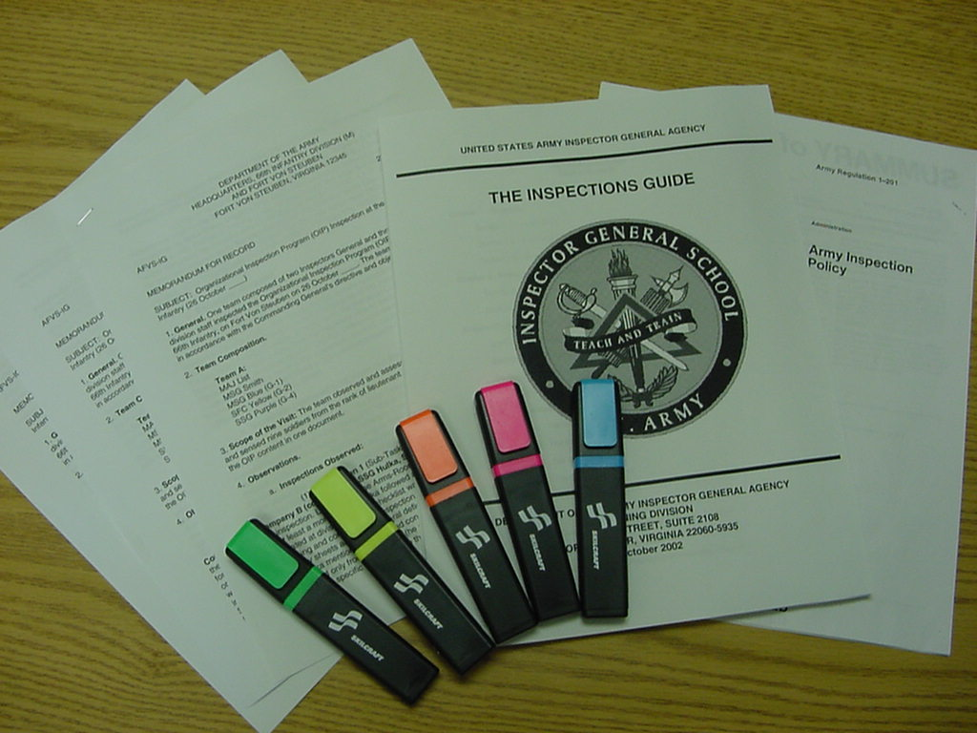
Step 1: Gather the Tools

Slide 65

Step 2: Develop a Writing Schedule
For example:
  12-14 November: Write Sub-Task 3.1
  15-17 November: Write Sub-Task 3.2
  18-20 November: Write Sub-Task 3.3
  21-23 November: Write Sub-Task 3.4
  28-29 November: Finish Chapter

Slide 66
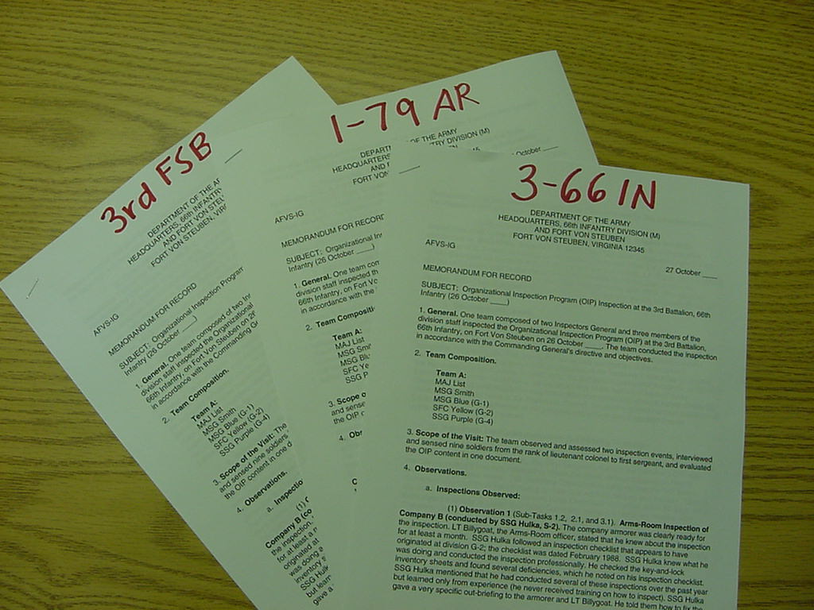
Step 3: Organize Your Sources
1-79 AR
1-66 AV
4-66 IN

Slide 67
Step 4: Review and
Study Your Sources
Go through each Trip Report and use the different colored markers to highlight the information for each of your Sub-Tasks. Use a different color for each Sub-Task.
Once you have highlighted the information, go back and read – in a leisurely fashion – all of the information pertaining to the first Sub-Task about which you will plan to write.
Absorb and try to understand the varying types of information without attempting to analyze or categorize the information. Let your mind wander freely!

Slide 68
4-66 Infantry Trip Report
(1) Observation 1 (Sub-Tasks 1.1, 1.3, and 3.2). Company Commander and First Sergeants Sensing Session. The First Sergeants felt that the battalion's OIP was executed carelessly and was intended to "check the block" without focusing on how to improve the inspected areas. The Company Commanders believed that the OIP was a distraction and kept them from focusing on their real wartime mission and training. None of the commanders present received an Initial Command Inspection within 90 days of assumption of command. All of them stated that they received their Initial Command Inspection well after 90 days of assuming command. The Company Commanders felt that these initial inspections were good but that no one ever followed up on the results to check for improvement. The First Sergeants said that these inspections were nothing more than a 'paper drill.' None of the Company Commanders had ever seen a written battalion OIP program. No written OIP programs existed at the company level.

Slide 69
4-66 Infantry Trip Report
(2) Observation 2 (Sub-Tasks 1.1, 1.3, 2.1, and 3.2). Interview with the Battalion Commander (LTC Johnson). LTC Johnson has been in command for 13 months. He admitted that he did not have a written OIP “as far as he knew.” He allows the XO to handle the OIP and conduct the program "the way the unit did it in the past." He has never seen a written brigade OIP but stated that the Brigade XO normally discusses OIP-related topics at the brigade staff calls. He was not aware of the division OIP memorandum and had never heard of AR 1-201. The battalion recently conducted some Staff-Assistance Visits to the companies in preparation for the Brigade Command Inspection in January, but some Company Commanders complained that the inspectors were too inexperienced or untrained. Initial Command Inspections for the companies normally occur several months after the command assumes command, but never within 90 days. LTC Johnson feels comfortable that the brigade is scheduling Command Inspections well in advance. He is not aware of any inspector-training programs within his battalion.

Slide 70
HHC, 2nd BDE Support BN Trip Report
(2) Observation 2 (Sub-Tasks 1.1, 3.1, and 3.2): Interview with the Company Commander (CPT Black). CPT Black stated that she had received at least four inspections during her 19 months in command. She stated that members of the division staff inspected her and conducted each inspection professionally. She appreciated the detailed feedback that she received at each out-briefing. CPT Black said that she had received her Initial Command Inspection during her first month of command and that a Subsequent Command Inspection followed six months later. CPT Black did not feel that the inspections were a burden, but she wished that the Brigade S-3 would ensure that her company’s inspections ended up on the Brigade Short-Range Calendar. The current calendar does not have HHC scheduled for an inspection, but she learned last month that she could expect an inspection in December.

Slide 71
1-66 Aviation Trip Report
(7) Observation 7 (Sub-Tasks 1.1, 1.3, and 3.2) Company Commander and First Sergeants Sensing Session. The Company Commanders felt that the constant number of inspections was cutting into their training and flying time. They thought that the inspections were “ridiculous and unfocused.” The battalion never spent a week inspecting one company at a time. Instead, the different staff sections inspected each company over a period of three or four months. The Battalion Commander was never involved. The First Sergeants agreed with their commanders’ assessments and stated that the Command Sergeant Major seemed to be the only one involved in the inspection process. Only one of the four commanders present had received an Initial Command Inspection during their first 90 days of command. The other commanders received their Initial Command Inspections after 90 days of assuming command.

Slide 72
Step 5: Develop Tools to Collect and Analyze Your Information
Findings | 4-66 IN | HHC, 2nd BDE Support BN | 1-66 AV
Battalions not conducting ICIs during first 90 days of command | -Battalion Commander says no ICIs under 90 days -CDRs/1SGs say no ICIs during first 90 days of command | -Company CDR says ICI during first month of command | -1 of 4 Company CDRs received ICI during first 90 days of command
Most ICIs occurring after 90 days of command | -Battalion Commander says ICIs usually done after 90 days of command -CDRs/1SGs say ICIs occur several months after taking command | -ICI’s occurred IAW AR 1-201 | -3 of 4 Company CDRs received ICI after 90 days of command

Slide 73
Step 6: Develop Your Finding Statement(s)
Possible Finding Statements:
  Finding 1: Most active-duty battalions are not conducting Initial Command Inspections in accordance with AR 1-201.
  Finding 2: Most active-duty battalions are conducting Initial Command Inspections for companies but not within 90 days of assuming command as prescribed in AR 1-201.

Slide 74
Step 7: Write Your Findings Sections
ELO
11
The Findings Section
Finding Statement: Write the finding statement as you developed it during Step 6.
Standard: Write out the standard word for word and omit nothing. Remember: A particular standard may not exist for your finding; therefore, simply use this paragraph to discuss the context for your finding.
Inspection Results: This section is possibly the most critical portion of your findings section. You must explain the nature of your finding and any other significant items that pertain directly to that finding. The individuals or staff agencies who will be acting on the recommendations will rely on this section heavily to identify and fix the problem.
The Inspections Guide, Section 4-3, pages 4-3-28 to 4-3-30

Slide 75
Step 7: Write Your Findings Sections
ELO
11
Root Cause: Follow the root cause analysis model outlined in the The Inspections Guide. Remember: Positive findings will not have a root cause.
Don’t Know Can’t Comply Won’t Comply
1. Never Knew 1. Scarce Resources 1. No Reward
2. Forgot 2. Don’t Know How 2. No penalty
3. Task Implied 3. Impossible to Do 3. Disagree
Reasons for Non-Compliance
The Inspections Guide, Section 4-3, pages 4-3-29

Slide 76
Step 7: Write Your Findings Sections
ELO
11
Recommendation: This paragraph must identify clearly and concisely what the IG recommends that a particular individual or staff agency should do to correct the problem.
  The paragraph will begin as follows: The IG recommends that . . .
  The recommendation must tag a specific individual or staff agency.
The Inspections Guide, Section 4-3, page 4-3-29

Slide 77
Step 8: Complete the Chapter
Compile all of the findings portions into one document using the established chapter format.
Read and re-read the chapter several times to ensure consistency and to avoid needless redundancy.
Read the chapter out loud to yourself to help eliminate grammar errors or extraordinarily long sentences.

Slide 78
Step 9: Submit the Chapter for Peer and Committee Review
Draft Chapter
START
Committee
Review
FINISH
Team Leader
Review
Committee
Meeting
Revise
Chapter
Editing

Slide 79
Analyze the Results
and Crosswalk
What is the Final Result of this step?
  The final result of this step is a Draft Version of the Final Report.
  This draft version will serve as the basis for your briefings to the proponents and to the commander.
  Develop a slide presentation or some other means to facilitate the briefing.
Practical Exercise 10
Graded Homework

Slide 80
UPDATE COMMANDER
The Inspections Process
Phase Two: The Execution Phase
IPR
8
Trends Analysis
Unit Out-Briefing
ANALYZE RESULTS
VISIT
OUT-BRIEF PROPONENT
UNITS
7
CROSSWALK
10
11
Trip Report
UPDATE COMMANDER
Draft Final Report
9
Update Briefing
The Inspections Guide, Section 4-3, pages 4-3-33 to 4-3-34

Slide 81
Out-Brief the Proponent
Who is the proponent?
  The person or staff agency responsible to fix the problem
  Each of your recommendations names a proponent.
  Before you brief your Final Report to the commander, ensure that you brief each affected proponent in advance as a courtesy
  The proponent may inform you that he or she is not the correct person – or staff agency – to fix the problem.
  Be professional! Remember: The proponent does not have to agree with your findings or recommendations.

Slide 82
UPDATE COMMANDER
The Inspections Process
Phase Two: The Execution Phase
IPR
8
Trends Analysis
Unit Out-Briefing
ANALYZE RESULTS
VISIT
OUT-BRIEF PROPONENT
UNITS
7
CROSSWALK
10
11
Trip Report
UPDATE COMMANDER
Draft Final Report
Inspections Results Briefing
9
Update Briefing
The Inspections Guide, Section 4-3

Slide 83
The Inspections Process
Phase Three: The Completion Phase
FINALIZE
REPORT
OUT-BRIEF COMMANDER
DISTRIBUTE REPORT
SCHEDULE FOLLOW UP
12
14
16
17
TASKERS
13
HANDOFF
15
The Inspections Guide, Section 4-4, page 4-4-2

Slide 84
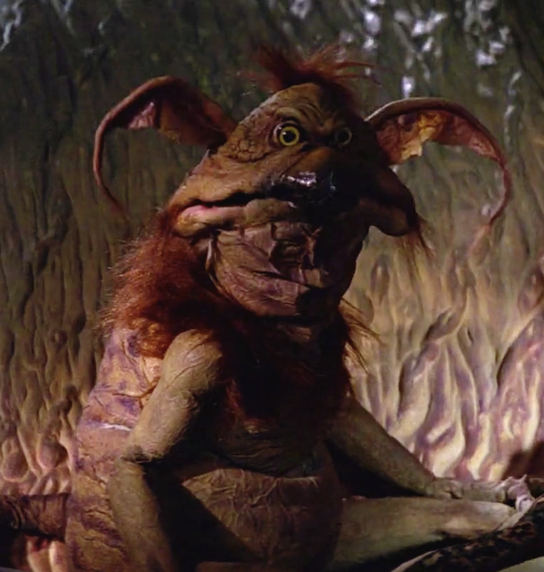

Out-Brief the Commander
  Develop a formal briefing to present the results of your inspection to the Commander.
  You must know your findings well and be able to speak in support of them. You may be telling the Commander some bad news that he or she does not want to hear!
  Request the Commander’s approval of the report following the briefing.
or

Slide 85
The Inspections Process
Phase Three: The Completion Phase
FINALIZE
REPORT
DISTRIBUTE REPORT
SCHEDULE FOLLOW UP
OUT-BRIEF COMMANDER
12
14
16
17
TASKERS
Inspections Results Briefing
13
HANDOFF
15
The Inspections Guide, Section 4-4, page 4-4-3

Slide 86
Taskers
  The individuals or staff agencies you listed in your approved recommendations will receive taskers to initiate the actions required to fix the problems.
  The IG’s role is to monitor the assignment of a tasker and to be aware of each tasker’s completion.
  The IG is not a tasking authority. The Commander, Chief of Staff, or G-3 should handle the taskers.
  Be prepared to work with the staff agencies or individuals tasked to help them solve the problem.

Slide 87
The Inspections Process
Phase Three: The Completion Phase
FINALIZE
REPORT
OUT-BRIEF COMMANDER
FINALIZE REPORT
DISTRIBUTE REPORT
SCHEDULE FOLLOW UP
12
14
16
17
Inspections Results Briefing
TASKERS
13
HANDOFF
15
The Inspections Guide, Section 4-4,
pages 4-4-4 to 4-4-6

Slide 88
Finalize Report
  Revise or adjust the Final Report based upon the Commander’s guidance or feedback.
  Develop a cover letter for the Commander’s signature that outlines his or her approval of the final report’s results. This cover letter will become the first page of the report.
  Submit a copy of the report to the Commander for review and for his or her signature on the cover letter.
  Conduct a final edit of the report to ensure accuracy and correctness.
  Ensure that the report does not name names or mention units! Confidentiality is important!

Slide 89
The Inspections Process
Phase Three: The Completion Phase
Completed Final Report
FINALIZE
REPORT
OUT-BRIEF COMMANDER
DISTRIBUTE REPORT
SCHEDULE FOLLOW UP
12
14
16
17
Inspections Results Briefing
TASKERS
13
HANDOFF
15
The Inspections Guide, Section 4-4, page 4-4-7

Slide 90
Handoff
ELO
1
  Handoff is the transferring of a verified finding to a higher-level agency or command that can correct the problem.
  Handoff occurs only when your Commander and staff cannot fix the problem at their levels.
  Handoffs can occur through the IG Technical Channels or Command Channels – or both!
  If you handoff through IG channels, enter the finding into IGARS as an Assistance Case and refer the IGAR to the next higher IG office.
  Handoffs through IG Technical Channels to DAIG go through the IG chain to the Analysis and Inspections Follow-up Office (SAIG-AI [AIFO]), as per AR 20-1, paragraph 5-1h(3).
  Always monitor the progress of a handoff so that you can keep your Commander informed.
The Inspections Guide, Section 4-4, page 4-4-7

Slide 91
Distribute the Report
Phase Three: The Completion Phase
Completed Final Report
FINALIZE
REPORT
DISTRIBUTE REPORT
OUT-BRIEF COMMANDER
SCHEDULE FOLLOW UP
12
14
16
17
Inspections Results Briefing
TASKERS
13
HANDOFF
15
Command Channels
IG Technical Channels
The Inspections Guide, Section 4-4, page 4-4-8

Slide 92
Distribute the Report
ELO
12
ELO
12
  Command IGs may release an inspection report to the Directing Authority, who in turn may release the approved report to other Army agencies and commands when an official need for the report is apparent
  The IG may distribute the inspection report to those units or staff proponents who will help improve the system, function, or program inspected or who may benefit from the report’s information
  Selected DAIG’s inspection reports are at (requires AKO access): https://armypubs.us.army.mil/publications/administrative/pog/TIG.aspx
  The Final Report must be properly marked
  AR 20-1, paragraph 3-4

Slide 93
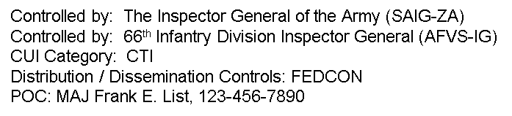
Marking the Report
  The Final Report must be properly marked as follows:
CUI
Top and bottom of each page must be marked with CUI Header and Footer in 16 font BOLD
Bottom right of front page marked as follows:
Controlled by: The Inspector General of the Army (SAIG-ZA)
Controlled by: 66th Infantry Division Inspector General (AFVS-IG)
CUI Category: CTI
Distribution / Dissemination Controls: FEDCON
POC: MAJ Frank E. List, 123-456-7890
SAIG Interim CUI Guidance to the IG Enterprise
dtd. 16 DEC 2020
CUI

Slide 94
Inspection Reports
ELO
12
AR 20-1 allows local IGs to release written inspection reports for official use after the commander approves the
report as long as it meets the following criteria:
Free of unit or individual information
Will not be used for adverse action
Will not be used to compare commands / commanders
Contains appropriate markings
Inspection Reports
Otherwise, TIG is the
Release Authority for
the IG records
AR 20-1, Paragraph 3-6

Slide 95
The Inspections Process
Phase Three: The Completion Phase
Completed Final Report
FINALIZE
REPORT
SCHEDULE FOLLOW UP
OUT-BRIEF COMMANDER
DISTRIBUTE REPORT
12
14
16
17
Inspections Results Briefing
TASKERS
13
HANDOFF
15
Command Channels
IG Technical Channels
The Inspections Guide, Section 4-4, page 4-4-9

Slide 96
Schedule Follow-Up
  An inspection is not complete if the inspecting agency does not follow-up to determine if the necessary corrective actions have occurred.
  Follow-up is an important inspection principle that applies to all Army inspections.
  You can follow-up an inspection using four different methods:
    Follow-Up Inspection: This method is the most effective but is also the most resource intensive.
    Follow-Up Visit: Visit the individuals or agencies responsible for the corrective action to determine their progress.
    Telephone: The same as a visit but not in person.
    Reply by Memorandum: This method should be considered as an exception to the rule, not a first course of action.

Slide 97
Departing Personnel
  Determine whether the temporary assistant IG, SME, Augmentee fulfilled their objectives and responsibilities
  Provide feedback to the appropriate supervisor regarding performance
  Recover all IG information and equipment
  Conduct an out-briefing reinforcing the IG tenet of confidentiality and the nature of IG records. Command IGs will ensure that a written memorandum for record documenting the out-briefing remains on file in the IG office for three years.
  Applies to departing IGs!
AR 20-1, Paragraph 1-13

Slide 98
IGARS Data for Inspections
  IGARS has a function code of 18E5 for tracking work load data associated with IG Inspections.
  IG offices should consider requiring each team member to enter an Information IGAR, with the title of the Inspection, as a roll-up of his or her man-hours expended in support of the inspection.
  Depending on your SOP, IGs can also load Inspection Products and man-hours into a Standard IGAR using this same function code.

Slide 99
The Inspections Process
RESEARCH
DEVELOP CONCEPT
PLAN IN DETAIL
TRAIN UP
PREPARATION
1
2
CDR
4
5
Inspection Purpose
Inspection Objectives
Concept
Memorandum
Sub-Tasks
Methodology
Task Organization
Baseline Methodology
Sample Itinerary
Notification Letter
Detailed Inspection Plan
Information-
Gathering Tools
Rehearsals
APPROVES CONCEPT
3
PRE-INSPECTION VISITS
Concept Briefing
Inspection Directive
6
IPR
8
ANALYZE
RESULTS
CROSSWALK
OUT-BRIEF PROPONENT
VISIT UNITS
Unit Out-briefing
Trends Analysis
EXECUTION
7
UPDATE CDR
Trip Report
10
11
9
Draft Final Report
Inspection Results Briefing
Update Briefing
OUT-BRIEF CDR
Completed Final Report
FINALIZE REPORT
DISTRIBUTE REPORT
SCHEDULE FOLLOW-UP
COMPLETION
12
TASKERS
Inspection Results Briefing
14
16
17
HANDOFF
13
15
The Inspections Guide
Chapter 4
Command Channels
IG Channels

Slide 100
The Compressed
Inspections Process
  The current operational environment is creating a number of systemic issues requiring IG attention.
  Inspections of systemic issues have a great impact on the readiness and warfighting capability of the organization.
  A special IG inspections process to accommodate the flurry of inspections does not exist.
  The IG must analyze the situation based on personnel, time, and other constraints and identify what parts of the inspections process to compress if necessary.
“Quick Look”
“Short-Fused”

Slide 101
Compressed IG Inspection
ELO
13
IGs can tailor The Inspections Process to remain responsive to the resource and time constraints of a deployed and operational environment.
IGs must adapt the process as necessary – a limited Compressed IG Inspection will mean that you vary, adjust, and limit the inspected population. IGs may compress some steps while combining others but will follow each phase of the process!
Remember to adhere to the five inspection principles outlined in AR 1-201!
The Inspections Guide, Section 8-2

Slide 102
Compressed IG Inspection
Associated Risk
IG Impact:
Small population size could affect validity of results.
Omitting process steps may breach inspection principles.
Limited information-gathering domains may not fully answer inspection objectives and identify root causes.
IG must emphasize to commander that data is limited.
Compressed inspections become the norm.
Command Impact:
Less ability to generalize the results to entire command.
Readiness / operational decisions made on limited data.

Slide 103
Compressed IG Inspection
The Preparation Phase
Research will be hasty but thorough and based upon available commander’s guidance / intent, references, information, and subject-matter experts. Objectives are essential to narrow your focus!
You can easily combine the Develop Concept and Commander Approves Concept steps. Draft a simple desk-side, oral briefing to the commander. You must still get a written Directive.
Plan in Detail by developing the minimum number of Sub-Tasks necessary. A simple methodology that only includes a task organization and sample itinerary will suffice.

Slide 104
Compressed IG Inspection
The Preparation Phase (continued)
  Notification can occur via landline telephone, radio, or some other expeditious means.
  Develop a Detailed Inspection Plan that outlines only the most essential parts of the inspection. (At a minimum: objectives, inspected units, dates and times of visits, approach, interview requirements, required documents and itineraries, and basic timeline.)
  Train-up as an inspection team by developing only the most necessary information-gathering products such as interview and sensing-session questions.
  Skip the Pre-Inspection Visit step if necessary to save time.

Slide 105
Compressed IG Inspection
The Execution Phase
When Visiting Units, spend only the time necessary to gather the information you need. Multiple inspection teams will help compress this step.
Be quick, be thorough, and be discreet!
Write Trip Reports that capture only the essential information related to the Sub-Tasks and Objectives.
If necessary, omit In-Process Reviews and formal unit out-briefings to save time.
Recommend during the Commander Approves Concept step to omit the Update Commander step.

Slide 106
Compressed IG Inspection
The Execution Phase (continued)
  The team should consider Cross-walking only those critical bits of information that demand verification.
  Final draft of the report may be in memorandum format. Don’t take shortcuts in the nine-step process to develop and write a five-paragraph Findings Section for each Sub-Task. The accuracy of the Findings Statements, the root causes, and recommendations are critical.
  Out-brief the Proponents only if time permits. Invite proponent members to the Commander’s Out-Briefing and give them an opportunity to comment.

Slide 107
Compressed IG Inspection
The Completion Phase
  Out-brief the Commander in the most expeditious and efficient manner possible (desk-side, in the Command Post, etc.)
  Provide the approved results to the Chief of Staff so the G-3 can assign Taskers immediately.
  Distribute the Report to subordinate commanders and proponents immediately for action as necessary.
  Conduct Handoff if practical, but focus on the problems you can fix at your level first.
  Follow up quickly and aggressively, but never omit the step!

Slide 108
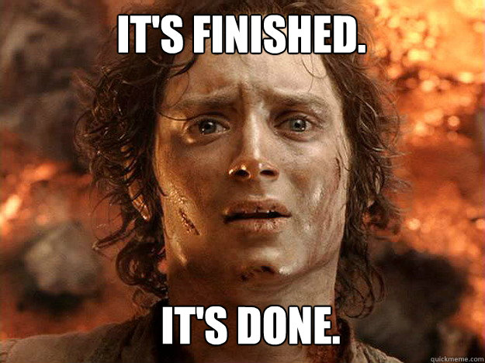
Questions?

